Slide 1
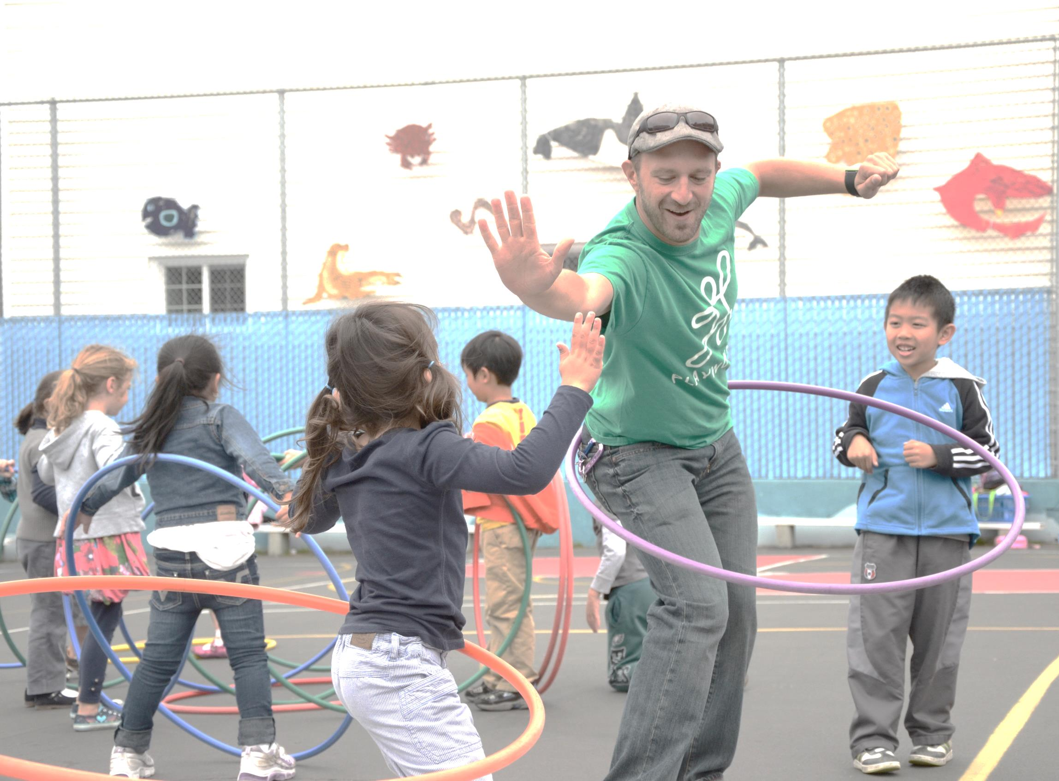

High Five Certificate of Appreciation
Is recognized for participating with a Power of Play Home Partner and bringing Safe & Healthy Play to the children of AZ!

